Slide 1




2025-2026
MONTANA OFFICE OF PUBLIC INSTRUCTION
MAST FOR
TEST COORDINATORS
1
opi.mt.gov

Slide 2

TRAINING OVERVIEW
Module | Slides
Module 1: MAST Overview | 4-17
Module 2: Scheduling and Scheduler Tool | 18-43
Module 3: User Management | 44-59
Module 4: Rostering Students | 60-69
Module 5: Entering PNPs | 70-81
2

Slide 3
TRAINING OVERVIEW (CONT.)
Module | Slides
Module 6: Notify Families of Testing | 82-88
Module 7: Preparing Test Administrators | 89-102
Module 8: Preparing Student Testing Devices | 103-108
Module 9: Monitoring Test Completion | 109-120
Module 10: Score Report Types & How to Access | 121-137
Module 11: Sharing Score Reports with Families | 138-153
3

Slide 4
2025-2026
MAST FOR TESTING COORDINATOR
MODULE ONE:
MAST OVERVIEW
4
opi.mt.gov

Slide 5
MODULE OBJECTIVE
Build foundational knowledge of the MAST assessment model
  Identify the key goals of MAST
  Understand the initial development timeline of MAST
  Understand the organization of MAST testlets
  Compare and contrast math and ELA testlets
  Find resources for MAST
5

Slide 6

MAST DEVELOPMENT OVERVIEW
What is MAST?
  General population ELA and math assessment
  Grades 3-8
  Features a series of short, standards-aligned math and ELA tests (testlets) administered throughout the year
  Provides timely and relevant feedback for teachers and students, as well as comparable summative data for education leaders and federal accountability
  This “classroom up” approach provides flexible opportunities for students to demonstrate learning while providing actionable data to stakeholders throughout the education system
6

Slide 7
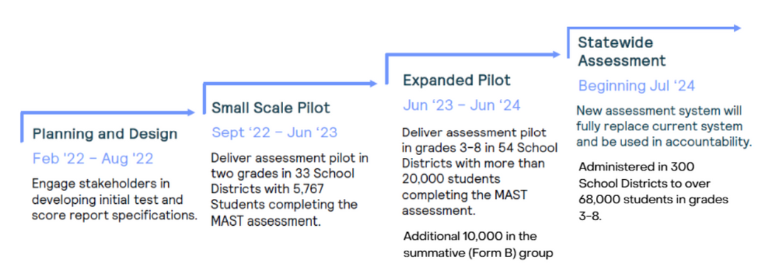
MAST DEVELOPMENT TIMELINE
7

Slide 8
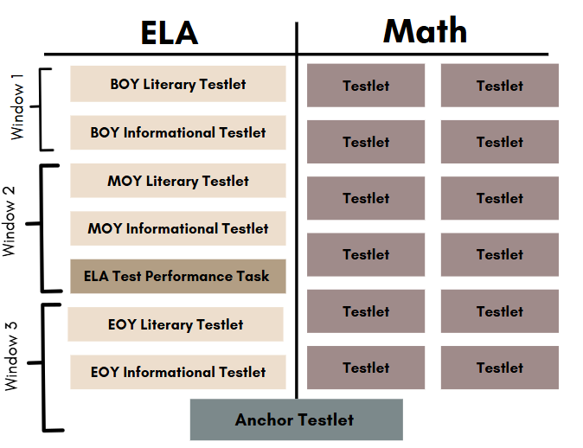
2025-2026 MAST DESIGN
8

Slide 9
2025-2026 TESTING OVERVIEW
 | Window 1 | Window 2 | Window 3
 | October 13 - December 5 | January 12 - March 6 | March 30 - May 22
 | 8 weeks | 8 weeks | 8 weeks
MATH | 3-5 Testlets | 3-5 Testlets | 3-5 Testlets
MATH | 3-5 Testlets | 3-5 Testlets | 1 Anchor Test
ELA | 2 BOY Testlets | 2 MOY Testlets Performance Task | 1 Anchor Test
ELA | 2 BOY Testlets | 2 MOY Testlets Performance Task | 2 EOY Testlets
9

Slide 10
MATH TESTLET DESIGN
  Each grade has 12 math testlets, each aligned to a strand of mathematical understanding, encompassing a small set of related content standards
  Testlets range from 9-13 items
  Question types include single/multiple choice, numeric text entry, and technology enhanced (matching table, inline choice, etc.)
10

Slide 11
ELA TESTLET DESIGN
  Each grade has 6 ELA testlets: literary and informational content for beginning, middle and end of year with passage-based and standalone syntax and vocabulary items
  Passages complexity increases as the year progresses
  Each testlet has 18 questions
  Question types include single/multiple choice, evidence-based selected response, and technology enhanced (matching table, inline choice, etc.)
11

Slide 12
ELA PERFORMANCE TASK DESIGN
  Administered as the last ELA task in Window 2
  Includes 5 non-scored reading questions from a previous testlet to elicit ideas for writing
  Constructed response performance task in the areas of written expression and knowledge of language and conventions
12

Slide 13
ANCHOR TESTLET
  Administered as the last testlet in Window 3
  Each student receives a pre-assigned math OR ELA testlet
    The ELA form will consist of 16 questions, including standalone and passage-based items.
    The math form will consist of 25 questions. Forms in grades 6-8 are divided into a calculator and non-calculator section.
  The Anchor Testlet plays a critical role in test development, including field testing and psychometric research.
13

Slide 14

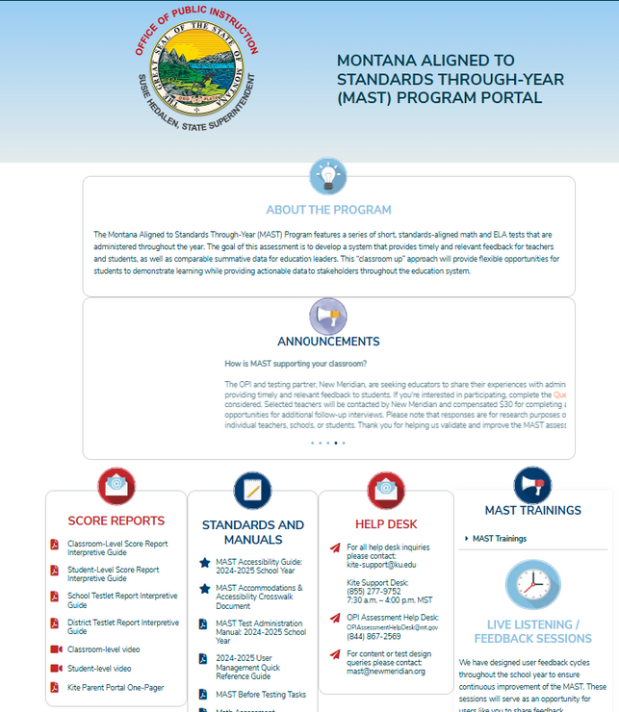
MAST PORTAL
Houses all available MAST resources, announcements, training schedule & recordings
Open access
14

Slide 15
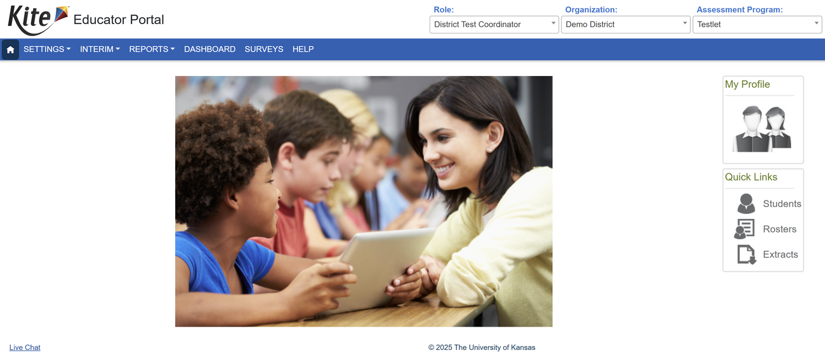
KITE EDUCATOR PORTAL
Portal for preparing, administering, and monitoring
completion of MAST testlets.
All STCs and ARs have accounts created for them by OPI.
All other user accounts must be created by a higher user role.
15

Slide 16
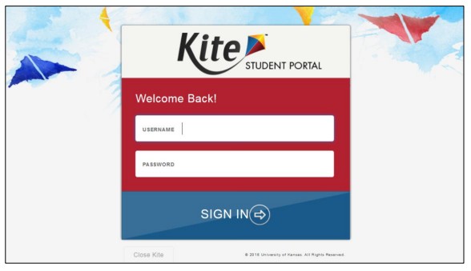
KITE STUDENT PORTAL
Secure browser where students take MAST testlets
Must be downloaded on each student testing device prior to testing
16

Slide 17
MODULE ONE RESOURCES
Theory of Action
Assessment Specifications & Blueprints
  Math
  ELA
Testing Windows
MAST Portal: the landing page of all MAST-related resources
Kite Educator Portal (unique MT login)
17

Slide 18
2025-2026
MAST FOR TESTING COORDINATORS
MODULE TWO:
SCHEDULING & SCHEDULER TOOL
18
opi.mt.gov

Slide 19
MODULE OBJECTIVE
Schedule math testlets to best align assessment to instruction
  Understand the scheduling flexibilities of math testlets
  Identify key personnel that will support the scheduling process
  Create a plan for collecting information required for submitting math testlet schedules
  Ensure access to the MAST Scheduler
  Disseminate testing schedules to all involved personnel
19

Slide 20
SCHEDULING MAST TESTLETS
Considerations for 2025-2026
  Testing windows are two weeks longer in the 2025-2026 school year with similar start dates
  Last year’s schedules will rollover into the same windows within the MAST Scheduler
  If no changes are made during the editing period, testlets will remain in the same windows as last year
  STCs will be loaded into the MAST Scheduler and can add building-level users to schedule testlets at the school level, but final submission must be done by the STC
20

Slide 21

2025-2026 MAST DESIGN
These 12 testlets are flexibly scheduled at the school level
21

Slide 22
2025-2026 TESTING OVERVIEW
 | Window 1 | Window 2 | Window 3
 | October 13 - December 5 | January 12 - March 6 | March 30 - May 22
 | 8 weeks | 8 weeks | 8 weeks
MATH | 3-5 Testlets | 3-5 Testlets | 3-5 Testlets
MATH | 3-5 Testlets | 3-5 Testlets | 1 Anchor Test
ELA | 2 BOY Testlets | 2 MOY Testlets Performance Task | 1 Anchor Test
ELA | 2 BOY Testlets | 2 MOY Testlets Performance Task | 2 EOY Testlets
All 12 testlets must be scheduled and administered across the 3 testing windows
22

Slide 23

SCHEDULING MAST TESTLETS
Who should be involved with testlet scheduling?
  District’s System Test Coordinator (STC)
  Any Building Test Coordinators (BTC) in the district
  Instructional/curricular leaders
  Teachers
23

Slide 24

SCHEDULING MAST TESTLETS
Tools for Scheduling Testlets
  Math pacing guides & school calendar
  Previous year’s MAST math testlet schedule
  Previous or upcoming year’s high-level lesson plans
  Any notes from the previous year’s pacing
  MAST Math Assessment Specifications
  MAST Scheduling Guide & FAQs for Test Coordinators
    Pg. 11: Math Schedule Worksheet
    Appendix B: MAST Math Testlets and Standards OR Math Standards Blueprint
24

Slide 25
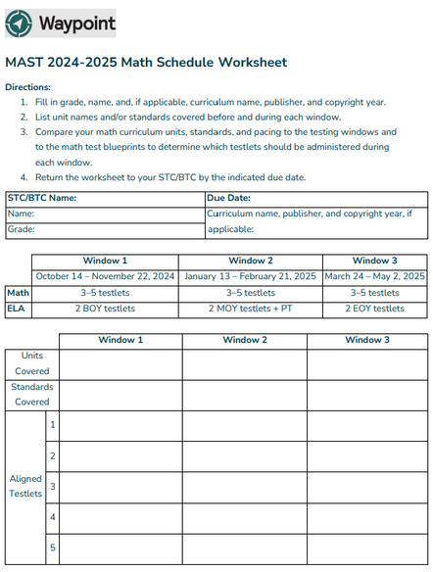
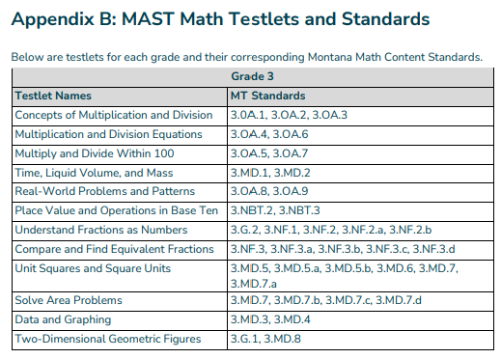
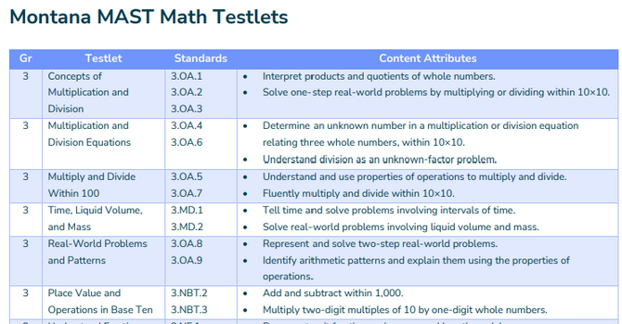
SCHEDULING MAST TESTLETS
Appendix B
The Math Schedule Worksheet and Math Standard Blueprints/Appendix B can be used together to help plan scheduling
Math Standard Blueprint
25

Slide 26
SCHEDULING MAST TESTLETS
Structures for Gathering Information
  Grade level PLC time
  School-wide planning time with grade level work and vertical alignment
  School leadership team using last year’s schedule and notes to draft a potential schedule that is shared with teachers for feedback and adjustment
26

Slide 27

SCHEDULING MAST TESTLETS
Discussions for Scheduling
  Is there a curriculum change for the upcoming school year?
  How well did math testlets align to instruction last year?
    Were there testlets that could have been administered earlier?
    Were there testlets that should have been moved to a later window?
  How will the move from six to eight week windows affect our scheduling?
27

Slide 28

WAYPOINT
Portal for scheduling testlets.
All STCs have accounts created for them by OPI.
STCs may delegate building users for each school.
28

Slide 29

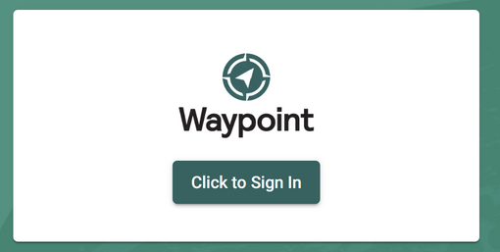
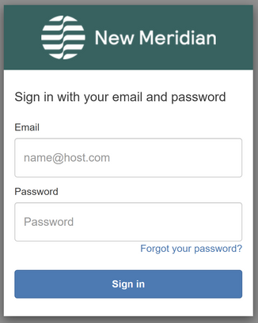
SCHEDULER ACCESS
Step-by-step scheduling instructions are located in the Scheduler User Manual
To log in to the Scheduler, follow these steps:
• Go to the login page at www.newmeridian.io.
• Enter your registered email address and password (case sensitive).
• Click Sign in to access your dashboard. If you encounter any issues during the login process, ensure that you have entered the correct email address and password.
If the problem persists, use the Forgot Password option to reset your password or contact support for assistance.
29

Slide 30
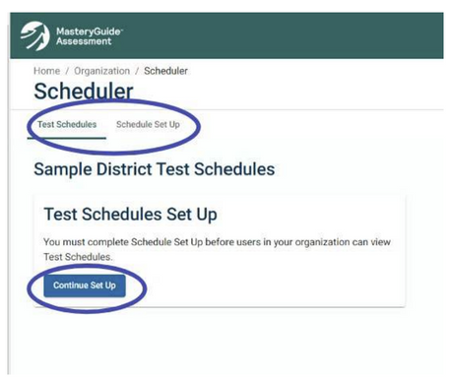
TEST SCHEDULES
Accessing Test Schedules
The Scheduler can be accessed via the left-hand navigation menu. Users designated to set up and publish test schedules will see a prompt either to Start or Continue Schedule Set Up. They will also see two tabs: Test Schedules and Schedule Set Up.
30

Slide 31
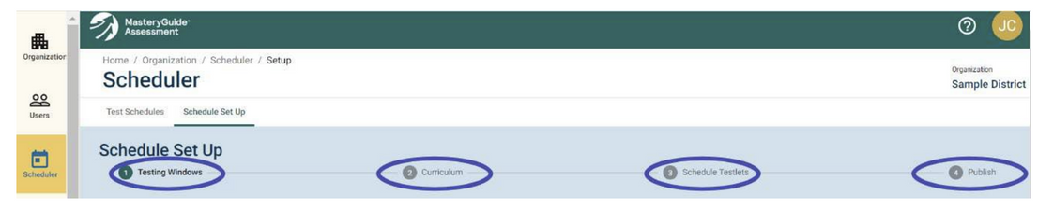
SCHEDULE SET UP
Only designated users as determined by your organization can access the Schedule Set Up tab.
The steps at the top of the page will guide you through the set-up process:
Step 1: Testing Windows – These have been set by OPI
Step 2: Curriculum – Decide whether to complete all scheduling yourself or delegate scheduling. If the former, you will enter Math curriculum information for each grade and complete Steps 3 and 4. If the latter, the designee(s) will complete the remaining steps.
Step 3: Schedule Testlets – Assign testlets to Testing Windows.
Step 4: Publish – Review Test Schedules and publish them to other users in your organization.
31

Slide 32
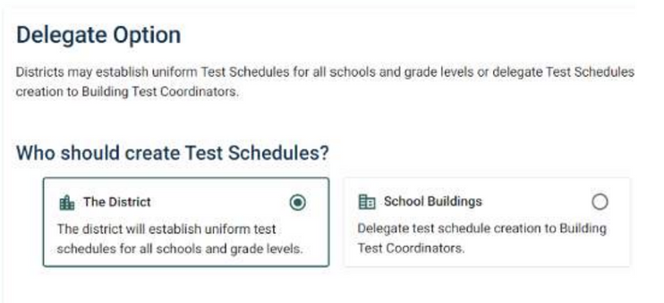
SCHEDULE SET UP
To establish uniform Test Schedules for all applicable schools and grade levels in your organization, select The District and proceed to Select Math Curriculum.
To delegate, follow these steps:
1. Select School Buildings.
2. Review the information about delegating.
3. Click Save and Next.
4. Review the confirmation prompt.
5. Click Save and Finish.
32

Slide 33
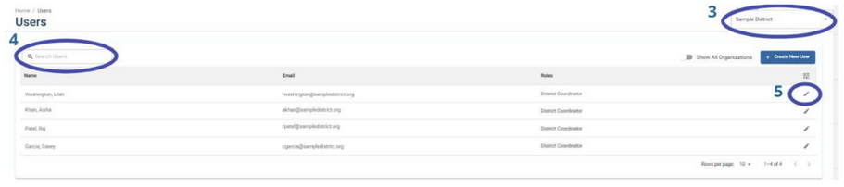
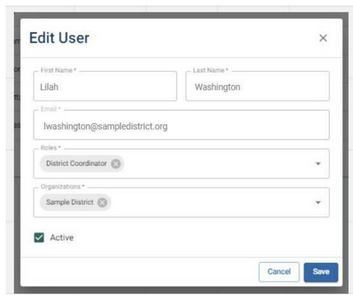
SCHEDULE SET UP
Edit or Deactivate Existing Users
To edit an existing user’s information, follow these steps:
1. Click Users in the left-hand navigation.
2. The Users page will appear.
3. Select the school or organization of the user you are searching for from the Organization drop down menu at the top right of the page.
4. Type the user’s name in the Search Users field to further narrow your search.
5. Click the pencil icon next to the user’s name in the table to edit their information.
6. The Edit User window will appear.
7. Make the necessary edits.
8. OPTIONAL: If you need to deactivate a user’s
access, deselect the Active checkbox.
9. Click Save.
33

Slide 34
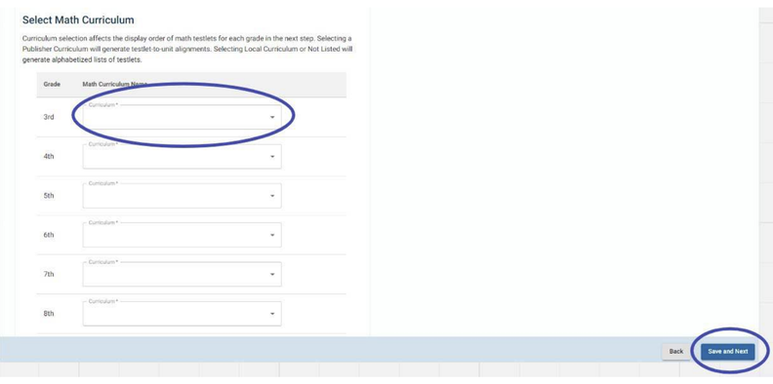
SCHEDULE SET UP
Math Curriculum selection affects the display order of math testlets for each grade in Step 3: Schedule Testlets.
  Selecting a Publisher Curriculum will generate testlet-to-unit alignments.
  Selecting Local Curriculum or Not Listed will generate alphabetized lists of testlets.
1. Select the applicable option from the Math Curriculum Name dropdown for each grade.
2. Click Save and Next.
Publisher Curriculum – If you see the name and copyright year of a publisher curriculum you use, select this option. Testlets must still be scheduled into individual windows if using this option.
Other: Local Curriculum – If you have a unique curriculum that does not come from a publisher, select this option.
Other: Not Listed – If you use a publisher curriculum not listed under Publisher Curriculum, select this option.
34

Slide 35
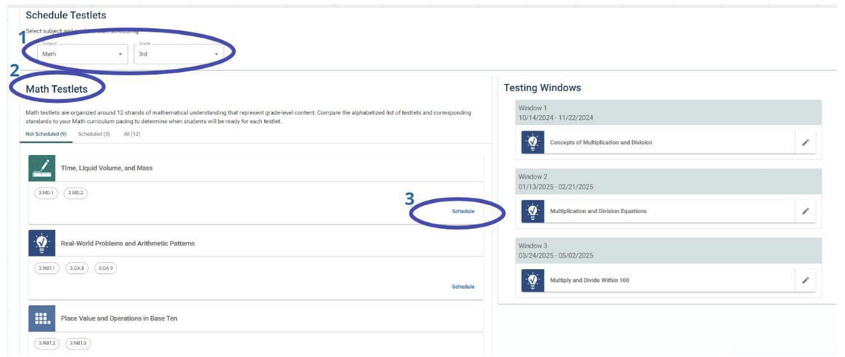
SCHEDULE TESTLETS
Schedule Testlets
1. Select the subject and grade from the Subject and Grade drop-down menus.
2. A list of testlets for the subject and grade will appear on the left.
3. Click Schedule for the testlet you wish to schedule. A new Assign Testlet window will appear.
4. Select the Testing Window from the drop-down menu on the Select Testing Window tab.
35

Slide 36
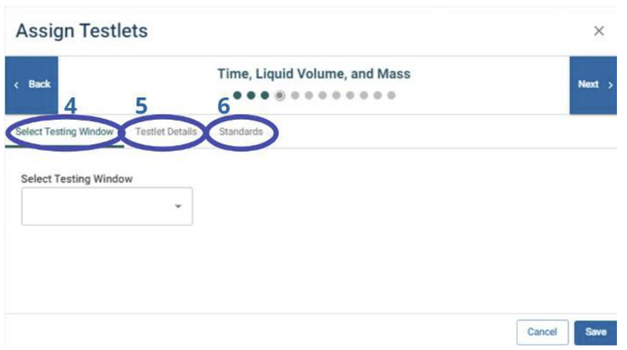
SCHEDULE TESTLETS
Schedule Testlets (cont.)
5. You may also click Testlet Details to learn more about each testlet.
6. You may also click Standards to see the descriptions for the standards covered in the testlet.
7. Click the Back and Next buttons to navigate between all testlets for the applicable subject and grade.
8. When you have finished assigning testlets to Testing Windows, click
Save.
36

Slide 37
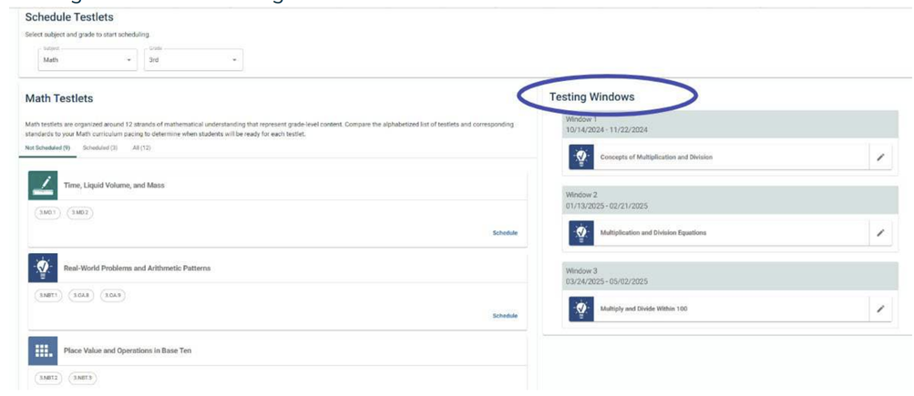
SCHEDULE TESTLETS
ELA testlets are pre-scheduled. You may use the subject drop-down to see the scheduled testlets but changes cannot be made.
Schedule Testlets (cont.)
9. The testlets you have assigned to windows will
populate under their respective Testing Windows on the right.
10. Repeat as necessary until all testlets for the subject and grade have been assigned to Testing Windows.
11. To continue scheduling for all grades, select a new grade from the
Grade drop-down menus.
37

Slide 38

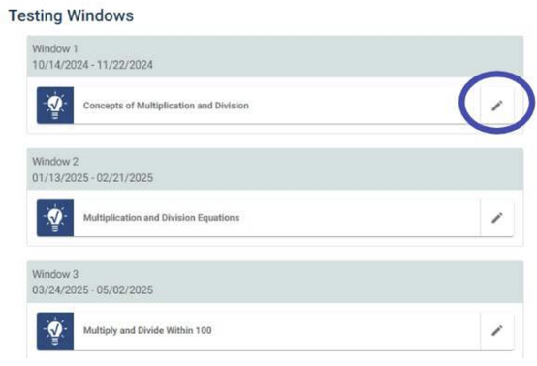
SCHEDULE TESTLETS
Check Schedules before Publishing
Once all testlets have been scheduled, you can review the Test Schedules before publishing. Print the draft schedule and check with all involved staff to ensure alignment and pacing.
Reminder: Once schedules have been published and the scheduling window is closed, no changes may be made for the school year.
To reschedule any testlets:
1. Select the applicable subject and grade from the drop-down menus.
2. Click the pencil icon next to the appropriate testlet under Testing Windows. The Assign Testlets window will appear.
4. Select the appropriate Testing Window from the Testing Window drop-down menu on the Select Testing Window tab.
5. When you have finished reassigning testlets to new Testing Windows, click Save.
38

Slide 39
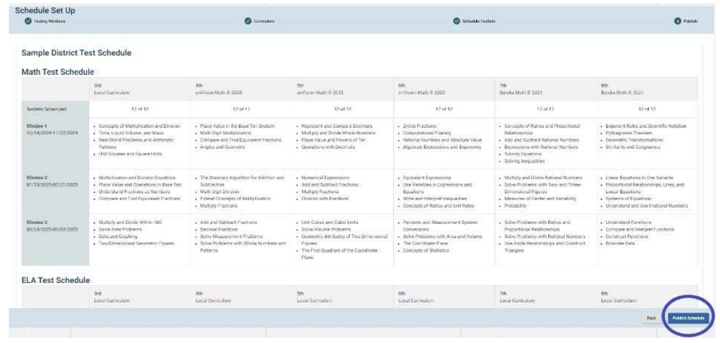
PUBLISH
Publish Test Schedules
1. Review the Test Schedules for applicable subjects and grades.
2. Click Publish Schedule at the bottom right.
3. A new Publish Schedule window will appear.
4. Review the Publish Test Schedules confirmation prompt.
5. If you wish to proceed, click Yes.
6. You will be redirected to the Test Schedules page
39

Slide 40
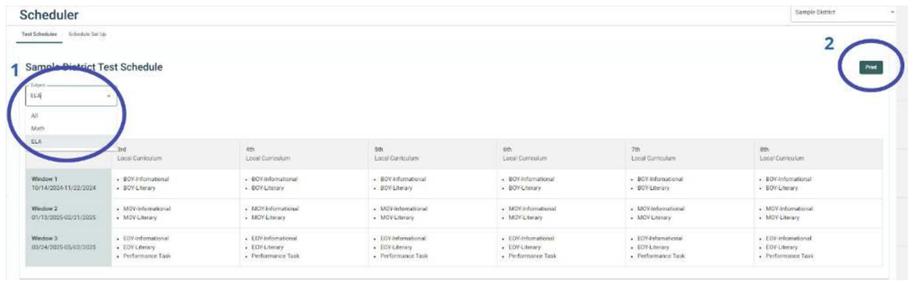
PRINT
View & Print Test Schedules
Once Test Schedules are published, all users in an organization will be able to view and print Test Schedules on the Scheduler page. Follow these steps:
1. Select the subject(s) you want to print from the Subject drop-down menu on the left.
2. Click Print.
3. A new window will appear with your web browser’s print function.
4. Use your web browser’s print function to implement your desired
action, such as printing or saving as a PDF.
40

Slide 41
DISSEMINATE
Who Should Receive Testing Schedules?
  Testing Coordinators
  Teachers administering MAST
  Special Education teachers supporting grade level instruction
  Support staff involved with instruction
  Anyone supporting MAST administration
41

Slide 42
REFLECT
Throughout the Year
  Have teachers make note of testlets that could be moved to earlier or later windows
  Allow time to discuss student results in reference to alignment
  Ensure all students in a school within the grade level are able to complete scheduled testing within each designated window-Testlets may not be rescheduled once the September deadline has passed
    Testlets may be rescheduled prior to the 2026-2027 school year
42

Slide 43
MODULE TWO RESOURCES
  MAST Before Testing Tasks
  MAST Scheduling Guide & FAQs for Test Coordinators
    MAST Math Scheduling Worksheet
  Math Assessment Specifications
  Math Standards Blueprint
  Testing Windows
  Waypoint Scheduler Tool Portal
    Scheduler Tool Manual
    Scheduler Tool Focused Support Video
All MAST-related resources can be found
on the MAST Portal
43

Slide 44
2025-2026
MAST FOR TESTING COORDINATORS
MODULE THREE:
USER MANAGEMENT
44
opi.mt.gov

Slide 45


MAST TESTING TASKS
The WHY: Successful administration of the MAST.
  Before Testing
    Train & Prepare Staff
    User Management
    Roster Students
    Enter PNPs
    Print Student Tickets & DACs
  During/After Testing
    Administer Testlets
    Monitor Completion
    Make-Up Testing
    Access & Sharing Score Reports
Kite Educator Portal
  Before Testing
    Prepare Student Testing Devices
    Student Practice Test
Kite Student Portal
  Before Testing
    Notify Families of Testing
  After Testing
    Provide guidance to parents/guardians on score report access & interpretation
Parents/
Guardians
45

Slide 46
MODULE OBJECTIVE
Manage users in the Kite Educator Platform
  Access the Kite Educator Portal
  Understand the roles, rights, and responsibilities within the Kite Educator Portal
  Add building level users to the Kite Educator Portal
  Add test administrators to the Kite Educator Portal
46

Slide 47
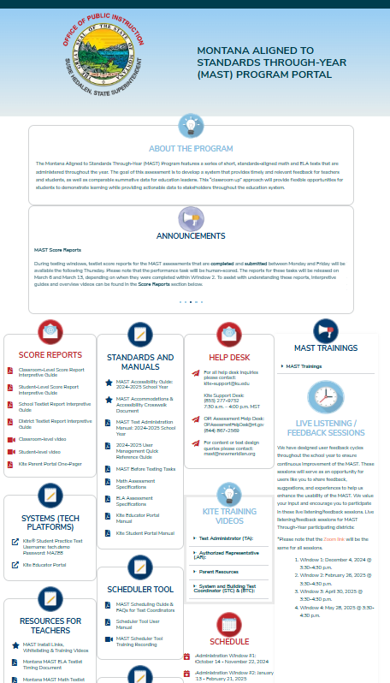
KITE EDUCATOR PORTAL ACCESS
Access the Kite Educator Portal through the MAST Portal.
Googling “Kite” and selecting from the search results may bring you to a different state’s portal
Kite Educator Portal
47

Slide 48
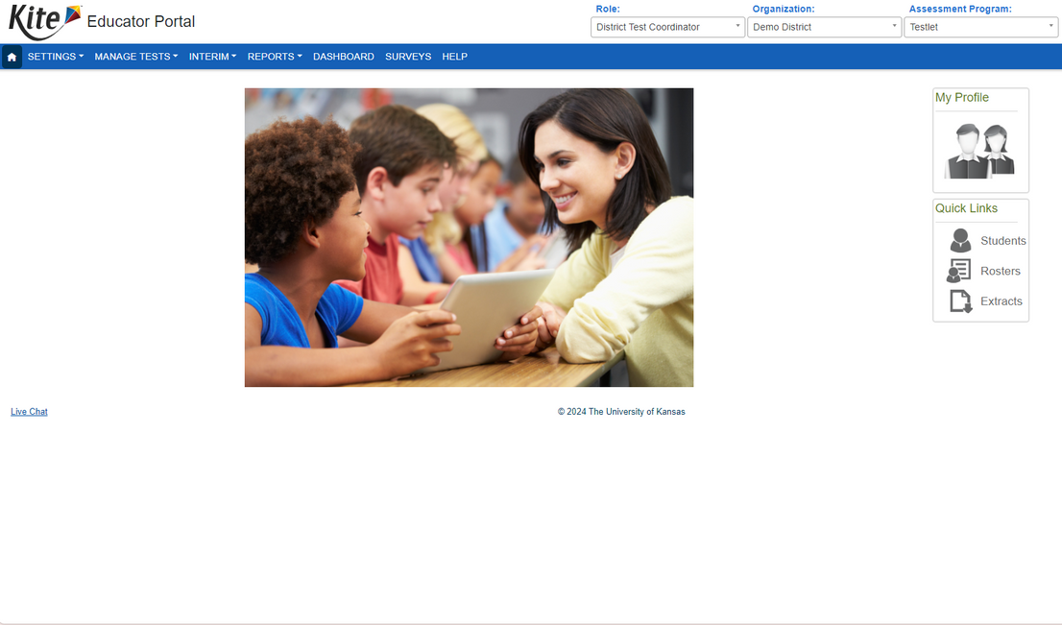
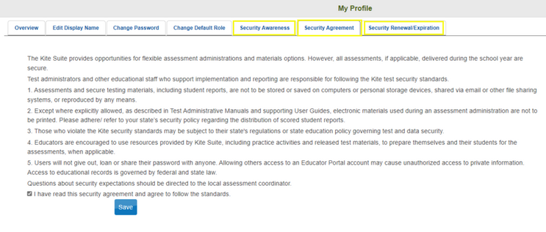
KITE EDUCATOR PORTAL
Each year you must agree to the Security Agreement.
It will appear automatically each year.
48

Slide 49
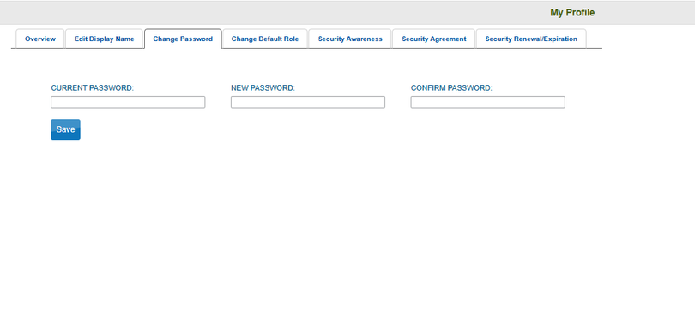

KITE EDUCATOR PORTAL
Kite passwords must be changed every 180 days. An automated email will notify you of the needed change.
Beginning July 25, 2025, Kite Educator Portal will require multifactor authentication as a way to further protect sensitive data and systems. Staff cell phone numbers can be entered proactively so that users can transition to the cell phone option, if desired, once the text feature is implemented.
49

Slide 50
USER MANAGEMENT
User Management
Users may assign any user role to the right and below their own role
ROLES IN THE KITE PLATFORM
DISTRICT TEST COORDINATOR (DTC)
DISTRICT USER (DU)
BUILDING TEST COORDINATOR (BTC)
BUILDING USER (BU)
TEACHER (TEA)
50

Slide 51
USER MANAGEMENT
District Level
CAPABILITIES IN THE KITE PLATFORM
DISTRICT TEST COORDINATOR (DTC)
Assigned to Authorized Representative (ARs) & System Test Coordinators (STCs) by the OPI
At the district level, DTCs:
  Manage Users: Add/modify DUs, BTCs, BUs, and TEAs
  Roster Students to Teachers
  Add/Modify Student PNPs
  Administer & Monitor Testlet Completion
  Set Up Kite Parent Portal: Add/Modify Student-Parent Connection
  View Student Score Reports
DISTRICT USER (DU)
Assigned to District Coordinators assisting with MAST tasks
At the district level, DUs:
  Manage Users: Add/modify BTCs, BUs, and TEAs
  All other Kite capabilities are the same as the DTC
Assigns
Assigns
Building & Classroom Roles
Assigns
Building & Classroom Roles
51

Slide 52
USER MANAGEMENT
School Level
CAPABILITIES IN THE KITE PLATFORM
BUILDING TEST COORDINATOR (BTC)
Assigned to Building Principals or other Building Coordinators
At the building level, BTCs:
  Manage Users: add/modify BUs and TEAs across the school.
  Roster Students to Teachers
  Add/Modify Student PNPs
  Administer & Monitor Testlet Completion
  View student score reports of all students within the school.
BUILDING USER (BU)
Assigned to Special Education teachers/specialists that will administer testlets & access student score reports across multiple grade levels
At the building level, BUs:
  Same Kite capabilities as a BTC except unable to add/modify users.
Assigns
Assigns
Classroom Roles
52

Slide 53
USER MANAGEMENT
Classroom Level
CAPABILITIES IN THE KITE PLATFORM
TEACHER (TEA)
Must be assigned to Test Administrators with rosters
At the building level, TEAs:
  Verify Student Information Prior to Testing (Rosters & PNPs)
  Provide Opportunities for Students to Utilize the Kite Practice Test
  Administer & Monitor Testlet Completion
  View Student Score Reports for students rostered to them
53

Slide 54
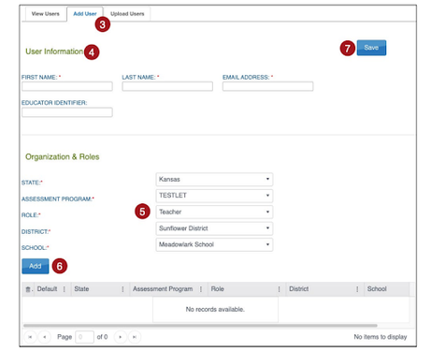
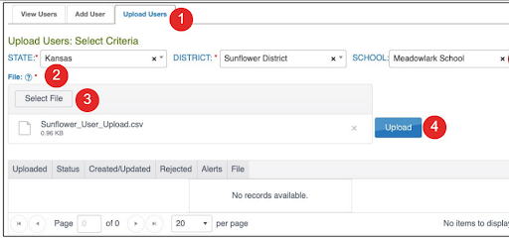
USER MANAGEMENT
User Management
METHODS TO ADDING/MODIFYING USERS
MANUAL METHOD TO ADD USERS
UPLOAD METHOD TO ADD USERS
Directions for each method can be found in the Kite Educator Portal Manual.
54

Slide 55
USER MANAGEMENT
MANUAL METHOD TO ADD USERS
1. Select Settings.
2. Select Users.
3. Select the Add User tab.
4. Enter the user’s first name, last name, and email address.
NOTE: The Educator Identifier must be a unique value and is required when Teacher is selected as role. It is suggested to use the teacher’s SEID for this field.
5. Choose the appropriate organization and role for the new user.
6. Select Add. The table will populate below.
NOTE: If adding more than one role to a user’s account, repeat steps 5 and 6 within this screen.
7. Select Save.
55

Slide 56
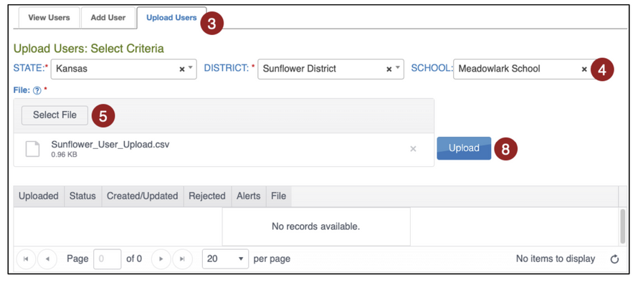
USER MANAGEMENT
UPLOAD METHOD TO ADD USERS
The user upload creates or updates users in Kite Educator Portal. The user upload also assigns 1-2 roles to a user (one is required). A CSV file template is available on the Upload Users tab in Kite Educator Portal (click on small blue question mark next to File). You will need to complete the CSV file using software such as Microsoft Excel outside of Kite Educator Portal. All users (teachers, test coordinators, etc.) can be included in one CSV file.
To upload multiple users using a CSV file, perform the following steps:
1. Select Settings.
2. Select Users.
3. Select the Upload Users tab.
4. Select the organization information.
5. In the File field, choose Select File.
6. Select the appropriate CSV file from your computer.
7. Select Open.
8. Select Upload.
NOTE: Users will be in Pending status until the user responds to the activation email.
56

Slide 57
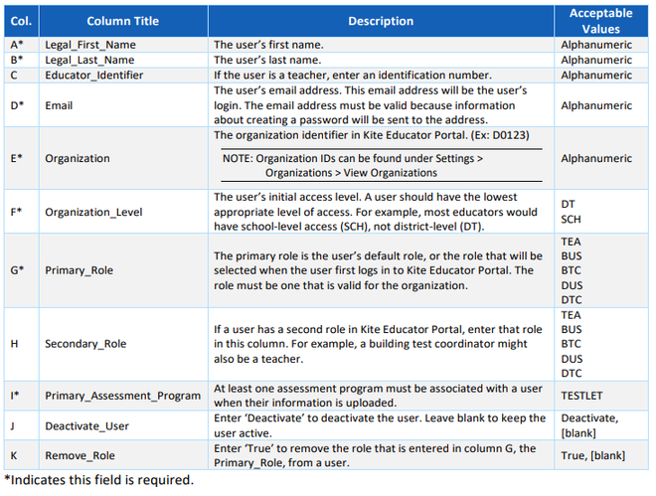
USER MANAGEMENT
UPLOAD METHOD TO ADD USERS
  Do not change column headers.
  Ensure cells are formatted to hold the leading zero of numbers, especially for school (SCH) and district (DT) level codes.
  Document should be saved in CSV format.
A table can be found in the Kite Educator Portal Manual with acceptable values for the template file.
57

Slide 58
USER MANAGEMENT
OTHER USER MANAGEMENT TASKS
Test coordinators and others responsible for data can take several actions with user accounts.
Please ensure any users no longer at your district are deactivated.
DEACTIVATE USER
Select the user, then select Deactivate. Note: Users can also be deactivated through the User Upload.
REACTIVATE AN INACTIVE USER
Inactive users only appear if the “Include Inactive Users” box is checked. To activate an inactive user, select the user, then select Activate.
RE-SEND ACTIVATION EMAIL
Select the user, then select the Send Activation Email button.
UNLOCK A LOCKED USER ACCOUNT
Select the user, then select Unlock.
CLAIM A USER FROM ANOTHER DISTRICT
Select the Claim Users tab. Enter the user’s First Name and Last Name OR the user’s Educator ID. Select Search. Select the user and then select Claim User.
Note: A user must be Inactive to be claimed. This means that their former district must have deactivated them previously.
58

Slide 59
MODULE THREE RESOURCES
  MAST Before Testing Tasks
  Kite Educator Portal (unique MT login)
  User Management Quick Reference Guide
  Kite Educator Portal Manual
  User Management Focused Support Video
  Kite Educator Portal Multifactor Authentication
All MAST-related resources can be found
on the MAST Portal
59

Slide 60
2025-2026
MAST FOR TESTING COORDINATORS
MODULE FOUR:
ROSTERING STUDENTS
60
opi.mt.gov

Slide 61
MAST TESTING TASKS
The WHY: Successful administration of the MAST.
  Before Testing
    Train & Prepare Staff
    User Management
    Roster Students
    Enter PNPs
    Print Student Tickets & DACs
  During/After Testing
    Administer Testlets
    Monitor Completion
    Make-Up Testing
    Access & Sharing Score Reports
Kite Educator Portal
  Before Testing
    Prepare Student Testing Devices
    Student Practice Test
Kite Student Portal
  Before Testing
    Notify Families of Testing
  After Testing
    Provide guidance to parents/guardians on score report access & interpretation
Parents/
Guardians
61

Slide 62

MODULE OBJECTIVE
Roster students for test assignment, monitoring, and reporting
  Understand the purpose of rostering and implications for reporting
  Ensure teachers are added to the Kite Educator Portal
  Create a roster assigned to a teacher
  Assign every student to a math and ELA roster
Rostering ad hoc coming soon!
62

Slide 63
ROSTERING OVERVIEW
Why Do All Students Need to Be Rostered?
  Rostering connects a student to the teacher that will have access to their testlet and through-year score reports
  Rostering ensures the correct testlets are assigned to each student
Who Should Students Be Rostered To?
  Students should be rostered to their primary instruction provider for math and ELA (these can be different teachers).
63

Slide 64

ROSTERING STUDENTS
Rostering Students
DTC, DU, BTC, or BU users in the Kite Platform have the capabilities to roster students to teachers that will administer MAST testlets. A reminder that a student can only be rostered to one teacher per subject area and must be rostered in both math and ELA.
Rostering can either be done manually or with an CSV upload.
Consider defining a standard naming convention for rosters, which can make sorting and finding a specific roster easier later. For example, if the teacher’s last name is followed by the subject to create the roster name, rosters appear neatly grouped when sorted alphabetically.
64

Slide 65
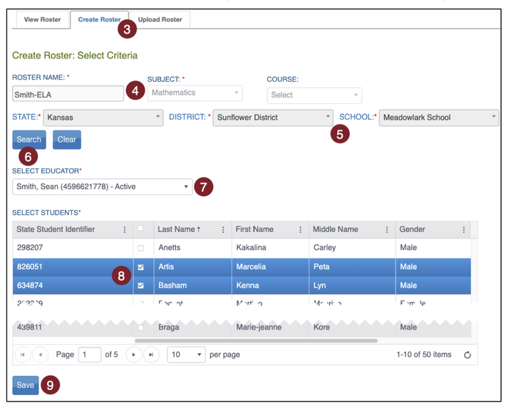
ROSTERING STUDENTS
MANUAL METHOD TO ROSTER STUDENTS
This method is best for rostering a small number of students and rostering new students
CREATING A NEW ROSTER
1. Select Settings.
2. Select Rosters from the drop-down menu.
3. Select the Create Roster tab.
4. Create the roster name and select the subject and course (if applicable) for this roster.
5. Select the district/school from the drop-down menu.
6. Select Search.
7. Choose the educator from the Select Educator drop-down menu.
8. Choose the students to roster by selecting the checkbox in the Select Student grid.
9. After selecting the appropriate students, select Save.
65

Slide 66
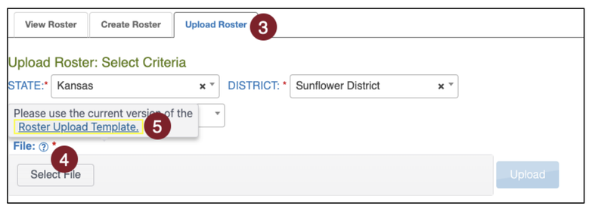
ROSTERING STUDENTS
UPLOAD METHOD TO ROSTER STUDENTS
This method is best for initial rostering of a large group of students.
ACCESS ROSTER UPLOAD TEMPLATE FILE
To roster students by uploading a CSV file, following these steps:
1. Select Settings.
2. Select Rosters.
3. Select the Upload Roster tab.
4. Select the question mark symbol next to the word File.
5. A small pop-up window will display the Roster Upload Template.
6. Select the link and open the Roster Upload Template file in a spreadsheet program that can save data in CSV (comma-delimited) format, such as Microsoft Excel. The file can only be uploaded using CSV format.
66

Slide 67
ROSTERING STUDENTS
EDITING AN EXISTING ROSTER
1. Select Settings.
2. Select Rosters from the drop-down menu.
3. Select the district/school from the drop-down menu.
4. Select Search.
5. All previously created rosters will display. Select the desired roster to edit/delete.
6. The View/Edit Roster screen will automatically display. The following edits can be made to a roster on this screen:
  Change the Roster Name.
  Change the educator connected to the roster by choosing another educator from those available in the Select Educator drop-down menu.
  Change the students connected to the roster. This includes adding and removing students from the roster.
  Delete the roster by deselecting all students from the roster.
7. Once all desired edits from the available choices are made, scroll to the bottom of the screen, and select Save.
67

Slide 68
ROSTERING QUESTIONS
What about students receiving additional services?
  Students should be rostered to the teacher providing their primary instruction.
  Specialists that see multiple students can be assigned BU roles to access student score reports and monitor students across rosters.
We only have one grade level ELA/math teacher that teaches multiple classes. Can we put all students in one roster?
  Yes, but keep in mind classroom reports and monitoring will put all those students together.
We have one teacher across multiple grade levels. Does each grade need a separate roster?
  No, multiple grades can be rostered together as long as they have the same teacher. Students just need to be on a math AND ELA roster.
68

Slide 69
MODULE FOUR RESOURCES
  MAST Before Testing Tasks
  Kite Educator Portal (unique MT login)
  Kite Educator Portal Manual
  Rostering Focused Support Videos
    Student Rostering
    Student Rostering (Upload Method)
All MAST-related resources can be found
on the MAST Portal
69

Slide 70
2025-2026
MAST FOR TESTING COORDINATORS
MODULE FIVE:
ENTERING PNP SETTINGS
70
opi.mt.gov

Slide 71
MAST TESTING TASKS
The WHY: Successful administration of the MAST.
  Before Testing
    Train & Prepare Staff
    User Management
    Roster Students
    Enter PNPs
    Print Student Tickets & DACs
  During/After Testing
    Administer Testlets
    Monitor Completion
    Make-Up Testing
    Access & Sharing Score Reports
Kite Educator Portal
  Before Testing
    Prepare Student Testing Devices
    Student Practice Test
Kite Student Portal
  Before Testing
    Notify Families of Testing
  After Testing
    Provide guidance to parents/guardians on score report access & interpretation
Parents/
Guardians
71

Slide 72
MODULE OBJECTIVE
Enter accommodations and designated supports for students through the PNP settings
  Identify the differences between universal, designated supports, and accommodations
  Ensure accommodations and designated supports reflect student need and daily learning environment
  Accurately enter accommodations and designated supports
72

Slide 73
PNP OVERVIEW
What is a PNP?
  A student’s PNP or Personal Needs Profile sets additional supports during testing within the Kite system.
What students should have PNP settings?
  Students with statewide assessment accommodations within active 504/IEPs or use designated supports in daily learning experiences.
Who can set PNPs?
  District and building level users have the ability to set PNPs. Teachers are able to view PNPs.
73

Slide 74
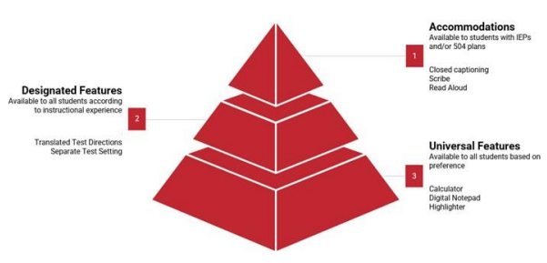
TYPES OF SUPPORTS
Accommodations
Documented through a student’s IEP or 504 plan.
Must be set in the PNP Settings before administration.
ex: Speech to Text, ASL
Designated Supports
Available to any student that has an identified need and uses the support on a regular basis in typical learning and assessment experiences.
Must be set in the PNP Settings before administration.
ex: Masking-Answer Choices, Reverse Contrast
Universal Features
Available to all students within the platform.
ex: Highlighter, Notes
A support is either embedded in Kite or non-embedded (provided to students outside of the platform)
74

Slide 75

SUPPORTS
Remember....
Statewide assessment supports should mirror a student’s regular learning and testing experience.
A student shouldn’t use an accommodation or support only for statewide testing.
75

Slide 76
SETTING PNPS
Setting Student PNPs
DTC, DU, BTC, or BU users in the Kite Platform have the capabilities to enter/modify student PNPs. A reminder that when PNPs are set, the accommodation or support is applied to testing in both math and ELA.
PNPs should be set at least 24 hours prior to MAST administration to ensure they are applied. If a student begins to test and PNPs are not showing up, stop testing and ensure settings have been applied in the Educator Portal.
76

Slide 77
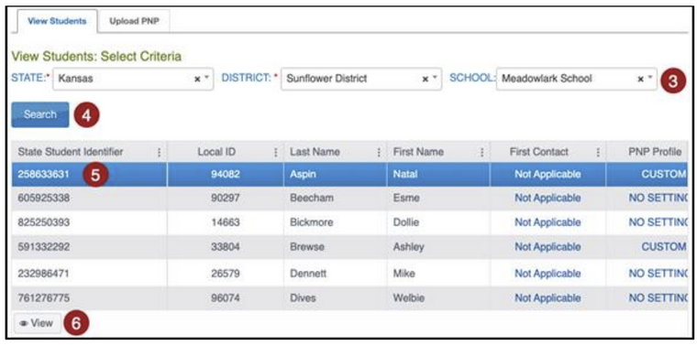
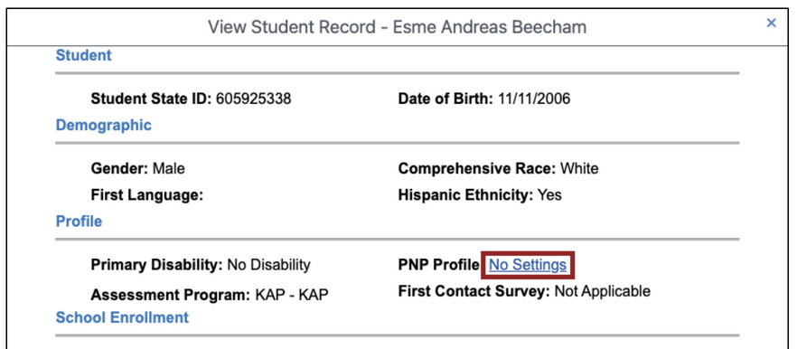
SETTING PNPS
SET OR UPDATE A PNP
1. Select Settings in the navigation menu.
2. Select Students.
3. Enter any required filters.
4. Select Search.
5. Select the State Student Identifier to highlight the row for the selected student.
6. Select View.
7. Select the No Settings link next to PNP Profile, or Custom if previously set
77

Slide 78
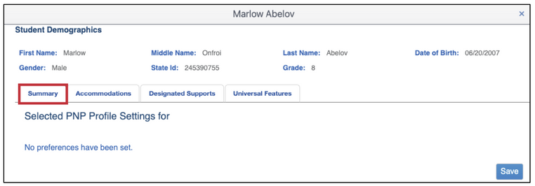
SETTING PNPS
SET OR UPDATE A PNP (CONT.)
8. The PNP settings popup window displays. At the top of the screen, student demographic data including full name, date of birth, gender, state student ID, and grade display. A summary of current settings (if any) is displayed in the center of the window. The Save button is located at the bottom of the window.
9. PNP settings are divided into the following categories: Accommodations, Designated Supports, or Universal Features. Select the tab to see available options. Refer to the MAST Accessibility Manual to determine which settings should be applied for your students.
78

Slide 79
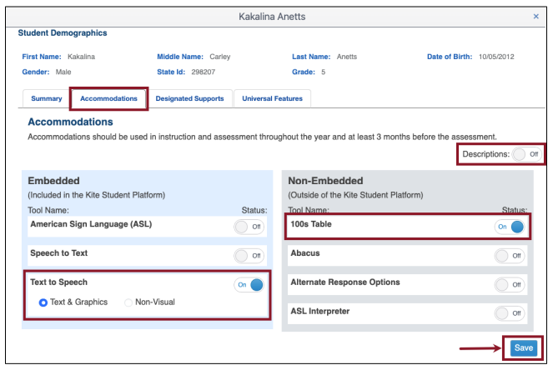
SETTING PNPS
SET OR UPDATE A PNP (CONT.)
10. The screen below shows a student that has Text to Speech: Text & Graphics and 100s Table selected. The Descriptions for each of the tools can be displayed by toggling on the switch.
11. Select Save when you have entered all student PNP settings. A confirmation message will display. Select Yes to save your changes. You then can view the settings you selected on the Summary tab.
79

Slide 80
PNP QUESTIONS
What students should have PNP settings turned on?
  Students with IEPs/504 with those accommodations written into current plans.
  Students using designated supports on a regular basis within classrooms.
What if a student starts testing and PNP settings aren’t showing up?
  Stop testing! Pause the test, have a building- or district-level user check the student’s PNP to ensure they are set correctly. Once set, PNPs should sync by the next day.
Many students have “separate setting” as an accommodation. What do I do?
  Ensure the IEP/504 accommodations match as closely as possible to the regular assessment environment for that student.
80

Slide 81
MODULE FIVE RESOURCES
  MAST Before Testing Tasks
  Kite Educator Portal (unique MT login)
  Kite Educator Portal Manual
  MAST Accessibility Guide
  Entering Student PNPs Focused Support Video
All MAST-related resources can be found
on the MAST Portal
81

Slide 82
2025-2026
MAST FOR TESTING COORDINATORS
MODULE SIX:
NOTIFYING FAMILIES OF TESTING
82
opi.mt.gov

Slide 83
MAST TESTING TASKS
The WHY: Successful administration of the MAST.
  Before Testing
    Train & Prepare Staff
    User Management
    Roster Students
    Enter PNPs
    Print Student Tickets & DACs
  During/After Testing
    Administer Testlets
    Monitor Completion
    Make-Up Testing
    Access & Sharing Score Reports
Kite Educator Portal
  Before Testing
    Prepare Student Testing Devices
    Student Practice Test
Kite Student Portal
  Before Testing
    Notify Families of Testing
  After Testing
    Provide guidance to parents/guardians on score report access & interpretation
Parents/
Guardians
83

Slide 84
MODULE OBJECTIVE
Notify parents/guardians of student participation in statewide assessments.
  Federal Requirement: Provide parents with transparency on testing including participation requirements, time requirements, and information available from the assessments in a timely manner (ESSA Section 1112).
  State Requirement: Notify parents using OPI guidance on the assessment purpose, requirement, and individual student performance including how these data will be used (ARM 10.56.102(6)).
84

Slide 85
PARENT/GUARDIAN NOTIFICATION OF TESTING OVERVIEW
How do I prepare the MAST Notice of Testing Letter for distribution to parents/guardians?
What is Montana’s requirement for participating in statewide testing?
85

Slide 86
PARENT/GUARDIAN NOTIFICATION
OF TESTING
OPI MAST Notice Letter Template
  Use OPI Parent Notice Letter Customization Checklist to prepare letter for distribution.
  Schools may notify parents through a variety of means of communication, such as a newsletter, e-mail, or by postal service as long as they are confident the communication will reach parents/guardians prior to testing & in a timely manner.
86

Slide 87
NOTIFYING PARENTS/GUARDIANS
OF TESTING
The MontCAS Policies and Procedures for Participation in Statewide Assessments explains the state participation policies and procedures to register and include students in each of the statewide assessments.
In Montana, there is no “opt out” law, and state law requires all students in public and accredited non-public schools to participate in statewide testing. Therefore, in accordance with ESEA-ESSA Section 1112(e)(1)(B)(ii), parents may refuse to have their child participate in statewide assessments, but the parent refusal will count negatively against the school’s participation rate within the accountability process.
87

Slide 88
MODULE SIX RESOURCES
OPI Parent Notice Letter Customization Checklist:
This checklist provides guidance on how to customize the OPI Parent Notice Letter.
MAST Notification of Testing Parent Template Letter
Six Things Stakeholders Should Know About Participation and Testing in Montana:
This document is to ensure that readers are aware of the significant value to stakeholders (e.g., students, parents/guardians, teachers, school leaders, and others) of the information derived from participating in state-level tests.
88

Slide 89
2025-2026
MAST FOR TESTING COORDINATORS
MODULE SEVEN:
PREPARING TEST ADMINISTRATORS
89
opi.mt.gov

Slide 90
MAST TESTING TASKS
The WHY: Successful administration of the MAST.
  Before Testing
    Train & Prepare Staff
    User Management
    Roster Students
    Enter PNPs
    Print Student Tickets & DACs
  During/After Testing
    Administer Testlets
    Monitor Completion
    Make-Up Testing
    Access & Sharing Score Reports
Kite Educator Portal
  Before Testing
    Prepare Student Testing Devices
    Student Practice Test
Kite Student Portal
  Before Testing
    Notify Families of Testing
  After Testing
    Provide guidance to parents/guardians on score report access & interpretation
Parents/
Guardians
90

Slide 91
MODULE OBJECTIVE
Support Test Administrators in preparing to administer MAST testlets
  Access the Kite Educator Portal
  Train Test Administrators: Roles & Responsibilities, and Test Security
  Completing the Test Security Agreement
  Support TAs in scheduling testlets within testing windows
  Share MAST resources
  Utilize OPI-provided Resources for TAs/Teachers training material (available Summer 2025)
91

Slide 92
PREPARING TEST ADMINISTRATORS OVERVIEW
How do TAs access the Kite Educator Portal for the first time?
What are Test Administrators’ roles and responsibilities for test security?
How do Test Administrators sign a Test Security Agreement for the MAST?
How do teachers schedule testlets within testing windows?
92

Slide 93
PREPARING TEST ADMINISTRATORS
Accessing the Kite Educator Portal
Things to remember:
  The activation email will be sent to your district registered email address.
  Be sure to check junk/spam in case email is rerouted.
  Be sure to bookmark and use the unique Montana Kite URL:
    https://educator-testlet.kiteaai.org/AART/logIn.htm
  Use your full district email address as the username when logging in.
93

Slide 94
KITE EDUCATOR PORTAL ACCESS
Access the Kite Educator Portal through the MAST Portal.
Googling “Kite” and selecting from the search results may bring you to a different state’s portal
Kite Educator Portal
94

Slide 95
PREPARING TEST ADMINISTRATORS
Perform Test Security Training
All individuals involved in state testing share responsibility for maintaining test security. School systems should ensure that all staff are familiar with their roles and responsibilities before, during, and after testing, as well as throughout the entire testing window.
TA responsibilities include:
• Complete the necessary training and certification requirements.
• Follow the OPI’s policies and procedures for test administration, test accessibility and test security.
• Administer state assessments in accordance with the assessment-specific Test Administration Manuals.
• Report any testing irregularities that occur to the Building Coordinator.
• See Appendix H: TA Roles and Responsibilities for Test Security.
95

Slide 96
PREPARING TEST ADMINISTRATORS
Key Information for Test Administration
Follow procedures for materials handling, test administration, test security and accommodations as outlined in the following documents:
  MAST Test Administration Manual
  MontCAS Test Security Manual
  MAST Accessibility Guide
Test materials must be kept secure when not being used for testing
  Test Administrators (TAs) and any trained school staff may not actively view, review, or analyze any secure items from statewide assessments.
  Test materials must not be reproduced (unless directed to do so for specific circumstances or assessments) or in any way released without the written consent of the OPI.
  Test questions may not be shared or discussed.
96

Slide 97
PREPARING TEST ADMINISTRATORS
Key Information for Test Administration
In the testing classroom
  What constitutes coaching?
  What constitutes a security breach/serious testing irregularity and how to report it?
  What materials can and cannot be displayed in the testing classrooms?
  Follow the procedures and guidelines outlined in the MAST Accessibility Guide for student accommodations and designated supports.
See MontCAS Test Security Manual for guidance.
97

Slide 98
PREPARING TEST ADMINISTRATORS
Submitting the Test Administrator Test Security Agreement
Each year you must agree to the Security Agreement. It will appear automatically each year.
98

Slide 99
PREPARING TEST ADMINISTRATORS
Schedule Testlets Within Testing Windows
Best Practice Considerations
  Administer as close to instruction as possible (at the end of the unit/chapter)
  Spread out testing throughout the window rather than clustering all testlets into the same week
  Use score reports for immediate and long-term instructional decisions (provided weekly during the window)
  Leverage testlet scheduling as an opportunity for district collaboration around curriculum and assessment
  Plan for make ups
99

Slide 100
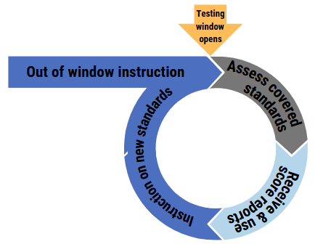


PREPARING TEST ADMINISTRATORS
Schedule Testlets Within Testing Windows
Think about how this cycle works.
Could your schedule better reflect this cycle?
100

Slide 101
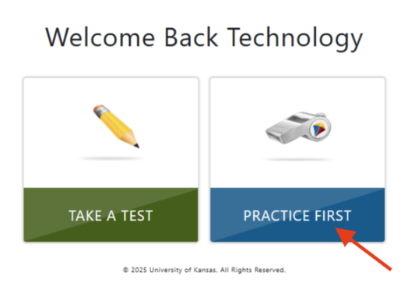
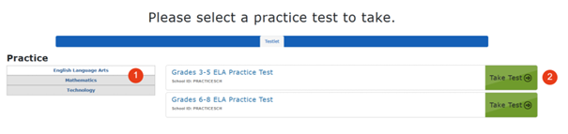
PREPARING TEST ADMINISTRATORS
Practice Tests
https://student-testlet.kiteaai.org/
username: tech.demo
password: MAZE8
Click on Practice First.
  Choose ELA or Math.
  Select the grade band then Take Test.
101

Slide 102
MODULE SEVEN RESOURCES
  Kite Educator Portal (unique MT login)
  MAST Test Administration Manual
  MontCAS Test Security Manual
  MAST Accessibility Guide
  MAST for Educators Slide Deck, PDF, & Facilitator Guide
All MAST-related resources can be found
on the MAST Portal
102

Slide 103
2025-2026
MAST FOR TESTING COORDINATORS
MODULE EIGHT:
PREPARING STUDENT
TESTING DEVICES
103
opi.mt.gov

Slide 104
MAST TESTING TASKS
The WHY: Successful administration of the MAST.
  Before Testing
    Train & Prepare Staff
    User Management
    Roster Students
    Enter PNPs
    Print Student Tickets & DACs
  During/After Testing
    Administer Testlets
    Monitor Completion
    Make-Up Testing
    Access & Sharing Score Reports
Kite Educator Portal
  Before Testing
    Prepare Student Testing Devices
    Student Practice Test
Kite Student Portal
  Before Testing
    Notify Families of Testing
  After Testing
    Provide guidance to parents/guardians on score report access & interpretation
Parents/
Guardians
104

Slide 105
MODULE OBJECTIVE
Prepare student testing devices before upcoming MAST administration
  Identify any changes to the Kite Student Portal.
  Identify actions for updating student testing devices before upcoming administration.
  Identify who should be involved (i.e. IT team, etc.).
105

Slide 106
PREPARE STUDENT DEVICES OBJECTIVES
Kite Student Portal Updates
  Windows: Same Student Portal app for SY25-26. Windows 10 no longer supported but can still be used with some limitations.
    Action: Due to how Windows handles system-level geolocation APIs and their interaction with security-restricted environments, like Kite Student Portal, location access is required. IT staff will need to make sure this is enabled as outlined in the SY25-26 Kite Student Portal Updates document.
  Chrome: Same Student Portal app for SY25-26.
    Action: School IT staff will need to make a slight change in the Google Admin console as outlined in the SY25-26 Kite Student Portal Updates document.
106

Slide 107
PREPARE STUDENT DEVICES OBJECTIVES
Kite Student Portal Updates (cont.)
  iPad: no changes for the 2025-2026 school year.
  Mac: no changes for the 2025-2026 school year.
107

Slide 108
MODULE EIGHT RESOURCES
  Install guides can be found on the MAST Portal:
    Chromebook
    Windows
    iPad
    Mac
  SY25-26 Student Portal Updates
108

Slide 109
2025-2026
MAST FOR TESTING COORDINATORS
MODULE NINE:
MONITORING TESTLET COMPLETION
109
opi.mt.gov

Slide 110
MAST TESTING TASKS
The WHY: Successful administration of the MAST.
  Before Testing
    Train & Prepare Staff
    User Management
    Roster Students
    Enter PNPs
    Print Student Tickets & DACs
  During/After Testing
    Administer Testlets
    Monitor Completion
    Make-Up Testing
    Access & Sharing Score Reports
Kite Educator Portal
  Before Testing
    Prepare Student Testing Devices
    Student Practice Test
Kite Student Portal
  Before Testing
    Notify Families of Testing
  After Testing
    Provide guidance to parents/guardians on score report access & interpretation
Parents/
Guardians
110

Slide 111
MODULE OBJECTIVE
Monitor testlet completion within window
  Meet federally mandated standardized testing completion guidelines in accordance with section 1111(c)(4)(E)(iii).
  Identify and understand different methods of monitoring testlet completion.
111

Slide 112

MONITORING TESTLET COMPLETION
Multiple Methods:
  Using the Dashboard (high-level)
    Reminder: this percentage shares percent of students completed with all testing for the window.
  Using the Test Administration Monitoring Data Extract
    Most useful for identifying individual students and testlets needing to be completed.
  Using the Test Monitor Screen
112

Slide 113
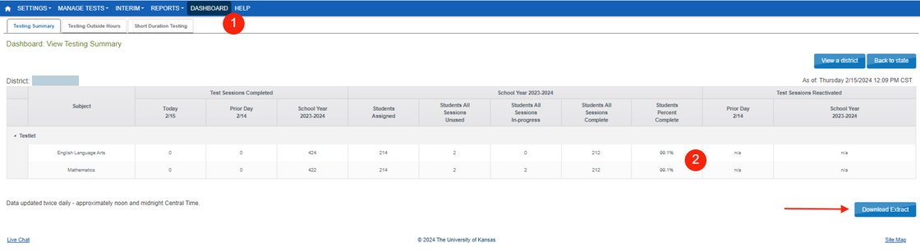
MONITORING TESTLET COMPLETION
Monitoring Testlet Completion Focused Support Video & Slides
Using the Dashboard
High level testlet completion can be monitored at the district level to ensure all students are completing testing. The Dashboard is updated at noon and midnight Central Time and shares the number of students that have completed all testing.
  DASHBOARD
  View by school or by district.
  Download Extract if needed.
113

Slide 114
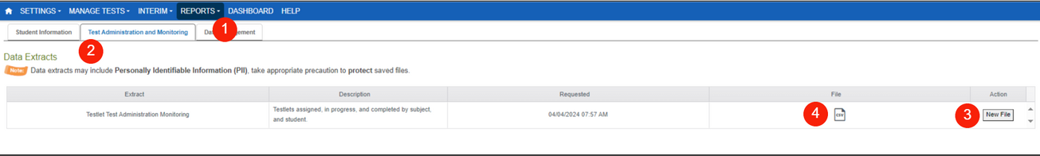
MONITORING TESTLET COMPLETION
Using a Data Extract
This method is the most efficient and effective method to find individual students and testlets needing to be completed.
Navigate to:
  REPORTS > DATA EXTRACTS
  Select the Test Administration and Monitoring tab.
  Click on New File.
  Once the file has loaded, click on the csv icon to download a document that can be filtered to identify testlets that in progress, unused, or paused.
Filtering must be performed to generate a list of students and names of testlets left to complete. Use this short video to learn how to filter the data extract.
114

Slide 115
MONITORING TESTLET COMPLETION
Using a Data Extract (Cont.)
This method is the most efficient and effective method to find individual students and testlets needing to be completed.
Filtering must be performed to generate a list of students and names of testlets left to complete.
Click here to access video if using pdf version of slide deck.
115

Slide 116
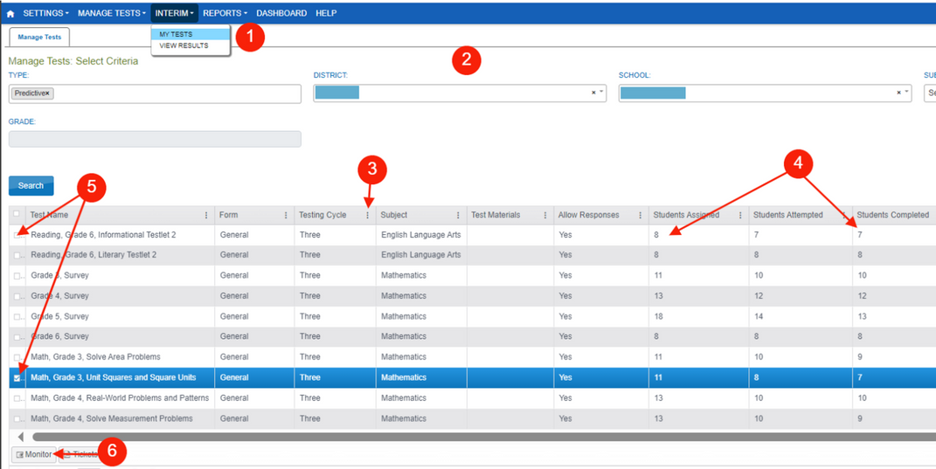

MONITORING TESTLET COMPLETION
Using the Test Monitor Screen
Testlet completion can also be monitored by grade level and testlet using filtering options in the INTERIM > My Tests section of the Kite Educator Portal.
  INTERIM > My Tests
  Fill out organizational information in the drop-down menus.
  Select the three dots to filter to see the appropriate testing window.
  Compare “Students Completed” to “Students Assigned”.
  Select the testlets that are not completed. Multiple testlets can be monitored. You can select up to 4.
  Select Monitor button.
116

Slide 117
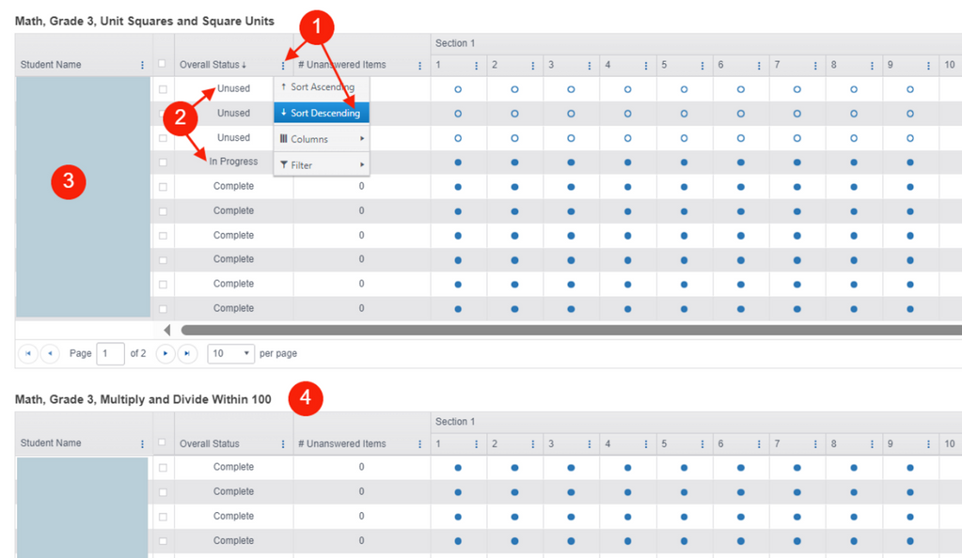
MONITORING TESTLET COMPLETION
Using the Test Monitor Screen
Once in the Monitor Screen:
  Select the three dots to filter in the “Overall Status” column. Choose Sort Descending.
  This will pull testlets to the top that are “Unused” (student has not started), “In Progress” (student has started but hasn’t completed), or “Paused” (student has not completed).
  Look to the associated Student Name for which students still need to complete testlets.
  Repeat steps #1-3 for the other testlets in the Monitor Screen.
117

Slide 118
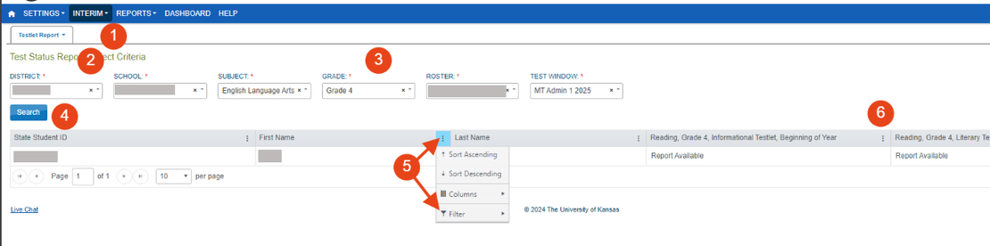
MONITORING TESTLET COMPLETION
Using the Test Status Report for
Student Mobility
Navigate to:
  INTERIM > VIEW RESULTS
  Testlet Report dropdown > Test Status Report
  Fill out the organizational information for the individual student.
  Click Search.
  Select the three dots in one of the student identifier columns (state ID, last name, or first name). Hover over Filter then click in the empty box under Show items with value that: contains [enter student's info]. Click on Filter.
  This will display ELA or math testlets for the student. If the cell under the testlet name says:
    Report Available: the student has completed the testlet, and a report is available.
    Unused: the student has not yet taken this testlet and should complete the assigned testlet at your district.
    N/A: the student took that specific testlet in a previous testing window in their previous district. Their score report is available.
118

Slide 119
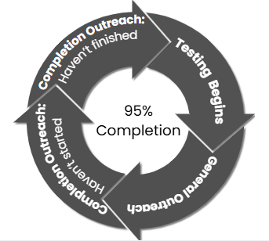
MONITORING TESTLET COMPLETION
General & Completion Outreach
General and Completion Outreach are ways the OPI helps to support districts in meeting federally-mandated standardized testing completion guidelines. Districts are expected to assess all eligible students at a participation rate of at least 95% in accordance with section 1111(c)(4)(E)(iii).
119

Slide 120
MODULE NINE RESOURCES
  Kite Educator Portal (unique MT login)
  Kite Educator Portal Manual
  Monitoring Testlet Completion Focused Support Video
All MAST-related resources can be found
on the MAST Portal
120

Slide 121
2025-2026
MAST FOR TESTING COORDINATORS
MODULE TEN:
SCORE REPORT TYPES &
HOW TO ACCESS
121
opi.mt.gov

Slide 122
MAST TESTING TASKS
The WHY: Successful administration of the MAST.
  Before Testing
    Train & Prepare Staff
    User Management
    Roster Students
    Enter PNPs
    Print Student Tickets & DACs
  During/After Testing
    Administer Testlets
    Monitor Completion
    Make-Up Testing
    Access & Sharing Score Reports
Kite Educator Portal
  Before Testing
    Prepare Student Testing Devices
    Student Practice Test
Kite Student Portal
  Before Testing
    Notify Families of Testing
  After Testing
    Provide guidance to parents/guardians on score report access & interpretation
Parents/
Guardians
122

Slide 123
MODULE OBJECTIVE
Understand how to access score reports
Understand the different types of score reports available
Interpreting & utilizing student score reports
123

Slide 124
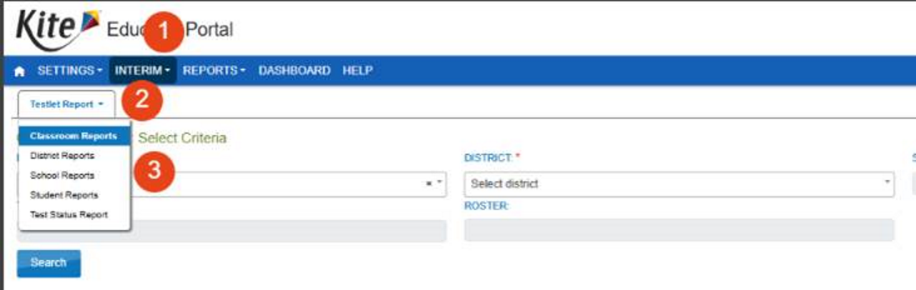
ACCESSING SCORE REPORTS
Navigate to:
  INTERIM > VIEW RESULTS.
  Click on the dropdown menu for Testlet Report.
  Classroom Reports is the default. Individual student reports and bundling options are available in the menu. Fill organization drop-downs then select Search.
  Available weekly during testing windows.
  Classroom Report location may be impacted by student mobility.
  ELA performance task score reports are hand-scored and will be released after the close of the window.
Reminder: District & School reports were available at the end of the school year for 24-25 and will be available after each window in 25-26
124

Slide 125
TYPES OF REPORTS
Testlet Reports | Summative Reports
Student Testlet Report Available weekly Shared in Kite Parent Portal with connected parents/guardians. Student Performance Task Testlet Report Two weeks after the close of Window 2 | Student Summative Report 2024-2025 available October 2025 2025-2026 available TBD
Classroom Testlet Report Available Weekly | Classroom Summative Report 2024-2025 available October 2025 2025-2026 available TBD
School Testlet Report Available after each window | School Summative Report 2024-2025 available October 2025 2025-2026 available TBD
District Testlet Report Available after each window | District Summative Report 2024-2025 available October 2025 2025-2026 available TBD
125

Slide 126
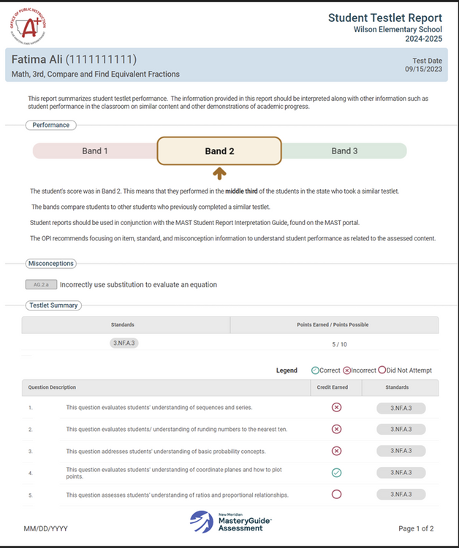
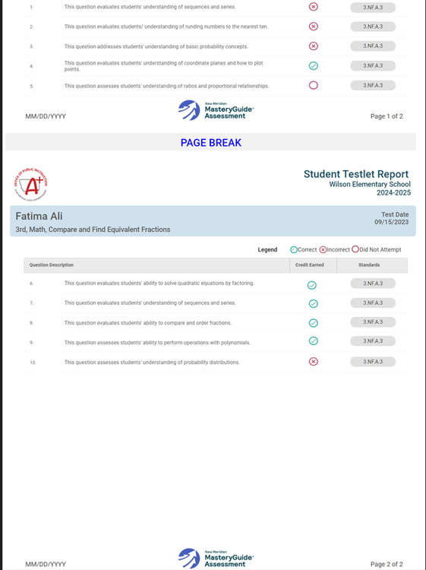
TYPES OF REPORTS
Student Testlet Report: Math
126

Slide 127
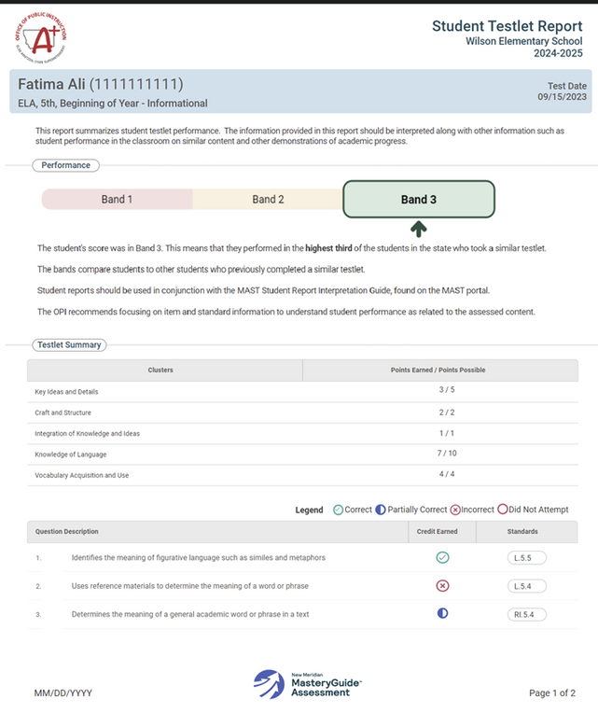

TYPES OF REPORTS
Student Testlet Report: ELA
127

Slide 128

TYPES OF REPORTS
Classroom Testlet Report: Math
128

Slide 129

TYPES OF REPORTS
Classroom Testlet Report: ELA
129

Slide 130

TYPES OF REPORTS
School Testlet Report: Math
130

Slide 131

TYPES OF REPORTS
School Testlet Report: ELA
131

Slide 132

TYPES OF REPORTS
District Testlet Report: Math
132

Slide 133

TYPES OF REPORTS
District Testlet Report: ELA
133

Slide 134
TYPES OF REPORTS
Summative Report: Math
Images available Fall 2025.
134

Slide 135
TYPES OF REPORTS
Summative Report: ELA
Images available Fall 2025.
135

Slide 136
INTERPRETING & UTILIZING SCORE REPORTS
General Guidelines
Each score report provides a snapshot of academic performance on a small set of related standards.
Score reports are meant to support professional judgment, not replace it.
Score reports should be considered alongside other information.
Individual test items assess different complexity levels and therefore are not designed to be averaged. Refer to Assessment Specifications documents for more information.
136

Slide 137
MODULE TEN RESOURCES
  Kite Educator Portal (unique MT login)
  Kite Educator Portal Manual
  Score Report Informational Videos
    Student-Level
    Classroom-Level
  Score Report Interpretive Guides
    Student-Level
    Classroom-Level
    School-Level
    District-Level
    Summative Report Guides available October 2025
  Accessing & Utilizing MAST Score Reports Focused Support Video
All MAST-related resources can be found
on the MAST Portal
137

Slide 138
2025-2026
MAST FOR TESTING COORDINATORS
MODULE ELEVEN:
SHARING SCORE REPORTS WITH FAMILIES
138
opi.mt.gov

Slide 139
MAST TESTING TASKS
The WHY: Successful administration of the MAST.
  Before Testing
    Train & Prepare Staff
    User Management
    Roster Students
    Enter PNPs
    Print Student Tickets & DACs
  During/After Testing
    Administer Testlets
    Monitor Completion
    Make-Up Testing
    Access & Sharing Score Reports
Kite Educator Portal
  Before Testing
    Prepare Student Testing Devices
    Student Practice Test
Kite Student Portal
  Before Testing
    Notify Families of Testing
  After Testing
    Provide guidance to parents/guardians on score report access & interpretation
Parents/
Guardians
139

Slide 140
MODULE OBJECTIVE
Distribute Score Reports to Families
  Federal Requirement: Provide timely individual student reports to parents, teachers, and principals and include the results on local report cards (ESSA Section 1111).
  State Requirement: statewide assessment public results must include a clear statement of the purpose, subject areas assessed, description of proficiency levels, and the percentage of students who participated in the assessments (ARM 10.56.105(2)) and (§20-7-104, MCA). School districts must also place students’ summative through-year reports in the student’s cumulative file per ARM 10.55.909.
  Share individual student testlet and summative through-year score reports with parents/guardians
140

Slide 141
DISTRIBUTE SCORE REPORTS TO FAMILIES OVERVIEW
Why do individual student score reports need to be distributed to families?
  Sharing student score reports with parents/guardians helps support student learning and success in the classroom. It’s important to help parents and families understand data and encourage them to talk with their student about strengths and areas of growth.
141

Slide 142
DISTRIBUTE SCORE REPORTS TO FAMILIES
OPI MAST Parent Score Report Letter Template
  Schools may notify parents through a variety of means of communication, such as a newsletter, e-mail, or by postal service as long as they are confident the communication will reach parents/guardians prior to testing & in a timely manner.
142

Slide 143
DISTRIBUTE SCORE REPORTS TO FAMILIES
METHODS TO DISTRIBUTE INDIVIDUAL SCORE REPORTS TO FAMILIES
  Hard copy delivery: Printing and distributing to parents/guardians in a way that works best for your district (i.e. mailing, parent/teacher conferences, etc.).
  The Kite Parent Portal: Districts make the student-parent connection in the Kite Educator Portal then share information to parents/guardians on how to access in the Parent Portal. Parents/guardians will have access to the student testlet-level score report on completed testlets within testing windows when reports release weekly.
  Infinite Campus: The OPI is working towards loading performance levels into Infinite Campus at the end of each testing window. This won’t be the full student report; however, districts will have the capability to upload full student score reports into IC if they choose.
  Individual student testlet results should be shared with parents/guardians in a timely manner.
  The individual student summative through-year report should be placed in student permanent files and shared with parents/guardians in a timely manner.
143

Slide 144
KITE EDUCATOR PORTAL ACCESS
Access the Kite Educator Portal through the MAST Portal.
Googling “Kite” and selecting from the search results may bring you to a different state’s portal
Kite Educator Portal
144

Slide 145
KITE PARENT PORTAL
SETTING UP THE KITE PARENT PORTAL OVERVIEW
  In the Kite Educator Portal, the student-parent connection is made at the district level.
    The student/parent connection can be made manually or through an upload using an ad hoc report from Infinite Campus (see Parent Portal Focused Support VIDEO - Presentation Slides).
    Instructions can be found in the Kite Educator Portal.
    Kite tutorial video
  After the student-parent connection has been made, a Kite Parent Portal Manual can be provided to parents to log in to access their child(ren)’s reports.
    A Kite tutorial video is available to support parents.
145

Slide 146

KITE PARENT PORTAL
SETTING UP THE KITE PARENT PORTAL
District-level user logs into the Kite Educator Portal and navigate to:
  Settings > Parents
  Choose the Upload Parent tab.
  Download the Parent Upload Template by clicking on the blue question mark.
    An ad hoc report can be generated out of Infinite Campus to help populate this template file (see Parent Portal Focused Support Video).
  After file is completed and saved on your device, click on Select File and choose the template file.
  Select Upload.
146

Slide 147

KITE PARENT PORTAL
FIELDS IN THE STUDENT-PARENT CONNECTION TEMPLATE FILE
Column A: Parent Email.
Column B: Student State Identifier (Can be found in a Kite Enrollment Data Extract or in Settings > Students)
Column C: District Identifier (Can be found in Settings > Organization. Use the number associated with district organization.)
Column D: Electronic Opt-In (Not required.)
147

Slide 148
KITE PARENT PORTAL
SETTING UP THE KITE PARENT PORTAL
Common Troubleshooting:
  Do not change column headers.
  Be sure to save template file in CSV format.
  Be sure your cells are formatted to hold leading zeros in numbers such as the District Identifier field.
148

Slide 149



KITE PARENT PORTAL
PARENTS LOGGING IN TO THE KITE PARENT PORTAL
Steps for parents/guardians to log in:
  Open a web browser and visit https://parentportal-testlet.kiteaai.org/.
  Enter their email address registered with their child’s school district in the Email Address field.
  Select Get Started.
  A temporary access code will be sent to their email address.
  The access code is entered in the area provided on the login screen.
  Select Let’s Go.
149

Slide 150

KITE PARENT PORTAL
PARENTS LOGGING IN TO THE KITE PARENT PORTAL
The homepage provides a brief overview of Kite Parent Portal as well as report details for assessments in which your child has available reports. To view all available reports, select View Reports under the child’s name.
150

Slide 151


KITE PARENT PORTAL
PARENTS LOGGING IN TO THE KITE PARENT PORTAL
1. Choose an assessment.
2. Choose a subject.
3. Choose a student.
4. Assessment Description shares a brief description of the assessment program.
5. View and read the Scoring Report Guides: Links to score report guides and other helpful information.
6. Choose a report and click on the PDF icon to download the report.
151

Slide 152
KITE PARENT PORTAL
PARENTS LOGGING IN TO THE KITE PARENT PORTAL
Common Troubleshooting:
  Access codes used to enter the site are randomly generated and are valid for 24 hours. The same access code can be used multiple times within a 24-hour period to enter Parent Portal. After 24 hours, a new access code will need to be generated.
  If you do not receive an email, check your junk or spam folder. If you did not receive or forgot your access code, select the Resend Access Code button
152

Slide 153
MODULE ELEVEN RESOURCES
  OPI MAST Parent Score Report Letter Template
  Setting up the Kite Parent Portal
    Kite Educator Portal (unique MT login)
    Kite Educator Portal Manual
    Kite Parent Portal One-Pager
  Student-Level Score Report Informational Video
  Student-Level Score Report Interpretive Guide
  Kite Parent Portal Focused Support Video
All MAST-related resources can be found
on the MAST Portal
153

Slide 154


Questions?
OPI Assessment Help Desk:
1-844-867-2569
opiassessmenthelpdesk@mt.gov
154
Notes:
With that, I can now open up for any lingering questions that may have not been answered earlier in today's session.
-------------------------------Pause
If you would like to receive a professional development unit for attending today’s webinar, we will put a link for the webinar evaluation form in the chat. Fill that out and we can get that renewal unit to you.
Again, if any questions come up outside of this webinar, feel free to reach out to our testing partners at New Meridian with any program and product design questions, the Kite Support Desk with any platform related inquiries or the OPI assessment help desk for assessment related inquiries.
Thank you so much for joining us today. We hope this has been an informative webinar to help support your district as we transition to the MAST assessment.

